Slide 1
Center for Disability Access & Resources
Welcome to AIM
Faculty & Staff

Slide 2
What is AIM and what can it do for Faculty & Staff?
AIM stands for Accessible Information Management (AIM).
Viewing Letters of Accommodations aka “Faculty Notification Letter”
Alternative Testing Agreements
Exam Upload/Download
AIM doesn’t apply to students in the College of Law. They will still need to contact Ms. Sullivan (Deborah.Sullivan@famu.edu) or Ms. Johnson (Gwendolyn.Johnson@famu.edu)
Please check your spam mail and mark emails from AIM as not junk and moved to your inbox.

Slide 3
CeDAR Website – AIM Tab www.famu.edu/cedar

Slide 4
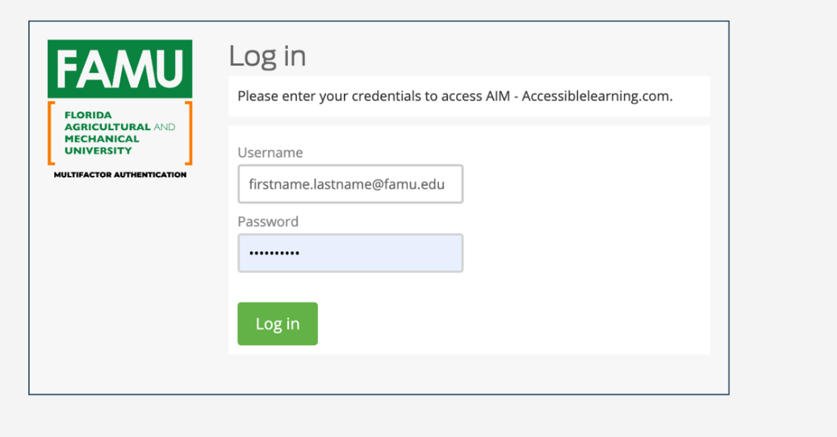
Faculty/Staff – Log in Page
https://whitney.accessiblelearning.com/FAMU/instructor
Enter FAMU login credentials to access Instructor portal through AIM.

Slide 5
Instructor Authentication Page

Slide 6
Faculty Home

Slide 7
Student Accommodation Letter → Faculty Notification Letter
Please check your spam mail and mark emails from AIM as not junk and moved to your inbox.

Slide 8
Alternative Testing Agreements

Slide 9
Alternative Testing Agreement

Slide 10
Alternative Testing Agreement

Slide 11
Alternative Testing Agreement

Slide 12
Alternative Testing Agreement - (Continued)

Slide 13
Alternative Testing Agreement - (Continued)

Slide 14
Alternative Testing Agreement - (Continued)

Slide 15
Alternative Testing Agreement - (Continued)

Slide 16
Alternative Testing Agreement - (Continued)

Slide 17
Exam Upload/Download

Slide 18
Exam Upload

Slide 19
Exam Upload

Slide 20
Exam Upload

Slide 21
Exam Upload

Slide 22
Exam Submission Confirmation

Slide 23
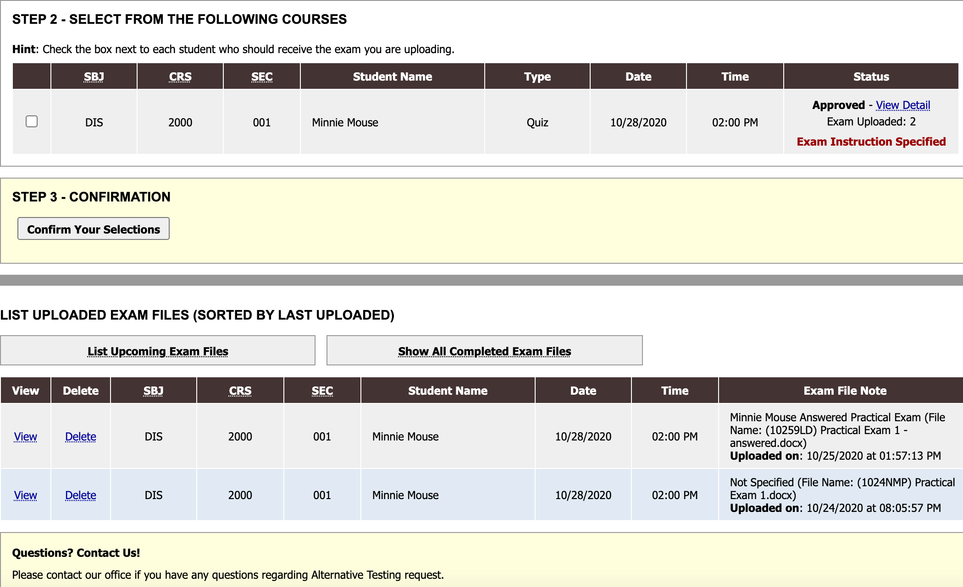
Exam Upload

Slide 24
Exam Download

Slide 25
Exam Download

Slide 26
Exam Download

Slide 27
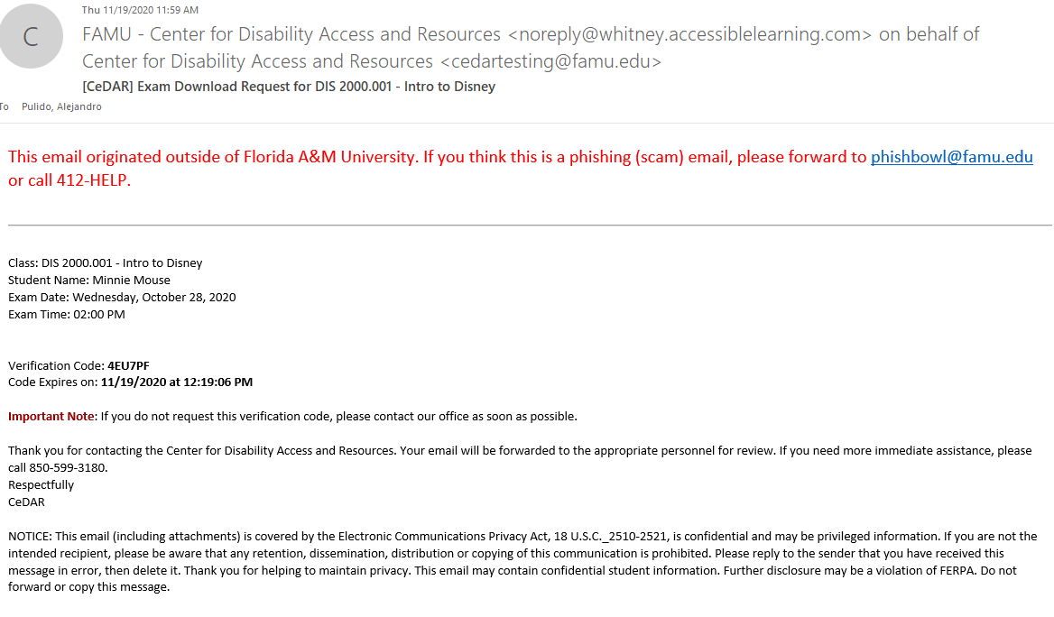
Exam Download

Slide 28
Exam Download

Slide 29
Contact Information
Phone: CeDAR 850-599-3180
Email: Cedar@famu.edu or Cedartesting@famu.edu
Website: www.famu.edu/cedar
Click on AIM Online Portal
Available for 1:1 Help
Please check your spam mail and mark emails from AIM as not junk and moved to your inbox.

